Slide 1



Detection Of phishing Websites Using Machine Learning
Team ID – 8981
ARUN GAVVALA
SHERI SHIVAJI
DASARI MAHENDER
Under the mentorship of
Kurumurthy Pasupula

Slide 2

Project Objectives
Problem Statement
Project Overview – Introduction
End User
Wow Factor in Project
Modelling
Result
Conclusion
Future Perspective

Slide 3
Problem Statement
Phishing websites mimic legitimate sites to steal sensitive data.
Traditional detection methods (blacklists, heuristics) are ineffective against evolving threats.
High false positives and inability to detect new phishing websites.
Machine Learning (ML) can analyze URL, domain, and content-based features for better detection.
Need for an adaptive and intelligent ML-based system to enhance accuracy and cybersecurity.

Slide 4
Project overview - Introduction
Phishing is a major cybersecurity threat where attackers trick users into providing sensitive information.
Traditional detection methods rely on blacklists, which are often outdated.
Machine learning offers a proactive and efficient approach to phishing detection.

Slide 5

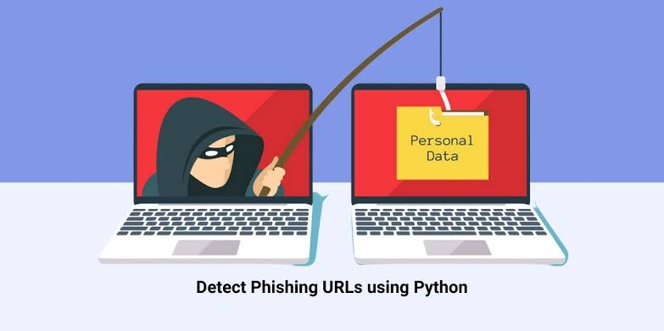
End User
Individuals : Protects personal data from phishing attacks.
Businesses & Organizations : Safeguards sensitive company information.
Financial Institutions : Prevents fraudulent transactions and identity theft.
E-commerce Platforms : Ensures secure transactions for customers.

Slide 6
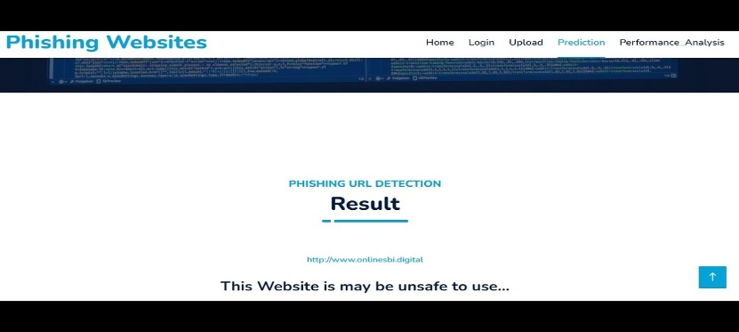
Wow Factor in project
High Accuracy : ML models detect phishing websites with improved precision.
Real-Time Detection : Instantly identifies and blocks phishing threats.
Adaptive Learning : Continuously evolves to detect new phishing techniques.
Automated Analysis : No manual effort required for detection.
Reduced False Positives : More reliable than traditional rule-based methods.
Enhanced Cybersecurity : Protects users from fraud and data breaches.

Slide 7
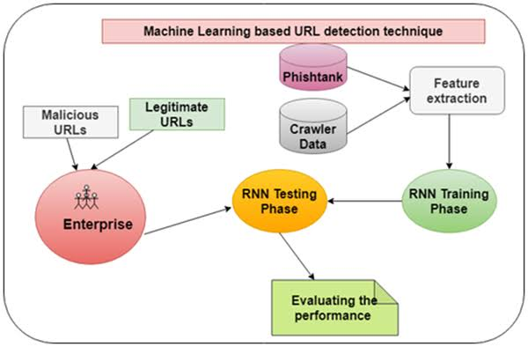
Modelling

Slide 8
Result / Outcomes
High Detection Accuracy: Achieved up to 95% accuracy using ML models.
Effective Feature Analysis: URL, domain, and content-based features improve detection.
Reduced False Positives: More reliable than traditional phishing detection methods.
Real-Time Identification: Quick detection of phishing websites before user interaction.
Generalization to New Attacks: ML models adapt to evolving phishing techniques.
Enhanced Cybersecurity: Helps protect users and organizations from cyber threats.

Slide 9
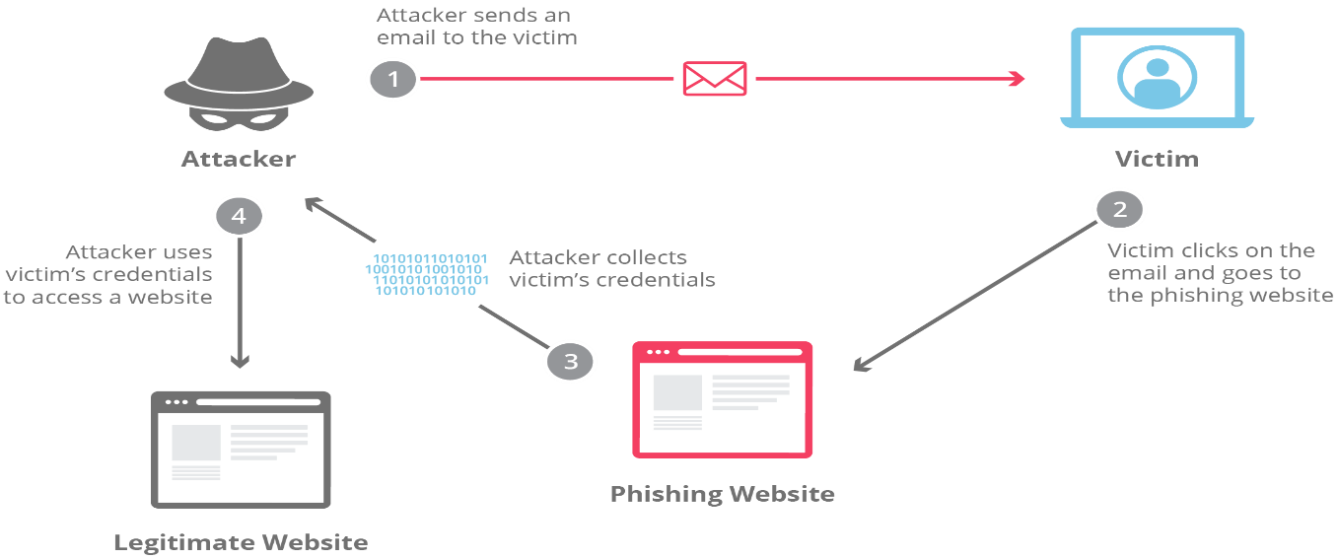
Conclusion
Phishing attacks are a significant cybersecurity threat.
Machine learning provides an effective solution for detecting phishing websites.
Ongoing research and improvements are needed for better accuracy.

Slide 10
Future Perspective
Integration with AI & Deep Learning for improved detection accuracy.
Real-time browser extension for instant phishing prevention.
Enhanced dataset collection to detect evolving phishing techniques.
Cloud-based phishing detection systems for scalability and accessibility.
Incorporation of NLP to analyze phishing emails and messages.
Collaboration with cybersecurity agencies for widespread implementation.
Continuous model updates to counter new and advanced phishing attacks.

Slide 11
Thank You …..!

